Slide 1
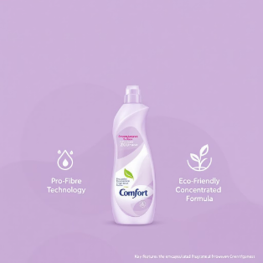
Driving Growth for Comfort Fabric Conditioner (Uniliver Product)
Comfort: Unilever's leading fabric conditioner brand since 1969.
Key Features:
Pro-Fiber Technology: Reduces fabric damage, extends garment life (Ultimate Care range).
Encapsulated Fragrance: Lasting freshness with micro-capsules.
Eco-Friendly: Concentrated formulas, 36% less plastic (UK)
Variants: Morning Fresh, Pure, Elegance, Perfume Deluxe.
Strategic Sales Plan 2024-2025
Sales Strategy
Retail Expansion: Target hotels and commercial laundries with 5L bulk packs.
Promotions: Bundle with Surf Excel/Dove detergents; offer "Buy 2, Get 1
Free" on refills.
Digital Campaigns:
TikTok/Reels: "Fragrance Burst" challenges showing scent release during movement.
Influencers: Partner with eco-conscious lifestyle creators to highlight sustainability.
Sampling Drives: Free sachets in e-commerce laundry orders (Amazon, Costco,
Walmart, etc).
Target Audience:
Primary:
Eco-Conscious Families: Focus on garment longevity and reduced plastic.
Young Professionals: Emphasize fragrance variety and convenience.
Secondary:
Hospitality Sector: Promote bulk 5L packs for linens.
Sensitive Skin Users: Push Pure variant via dermatologist collaborations.
Expected Outcomes:
Metrics:
Sales Growth: 15% YOY increase in key markets (India, UK).
Market Share: +5% in fabric conditioner segment by Q4 2025.
Brand Recall: 20% uplift via digital campaign engagement (measured through CTRs).
Sustainability Impact::
25% adoption of Ultimate Care range, reducing fast-fashion waste.
100% recycle-ready bottles by 2025.
Sources: https://www.unilever.co.uk/brands/home-care/comfort/, https://www.hul.co.in/brands/home-care/comfort/, https://www.unilever.com/news/news-search/2021/conditioning-clothes-to-last-longer-with-comforts-new-ultimate-care/, https://www.unilever.co.za/brands/home-care/comfort/, https://unilever-professional.com/products/comfort-fabric-conditioner-5l

